Slide 1
Cervical Cancer Classification using Neural Networks
Naman Rajani
Aryan Bhagat
Notes:
Before we start the pitch, we would like to have a disclaimer as the pictures in this presentation are graphic.
Hello, We are HerAI and we provide personalized health care for women.

Slide 2
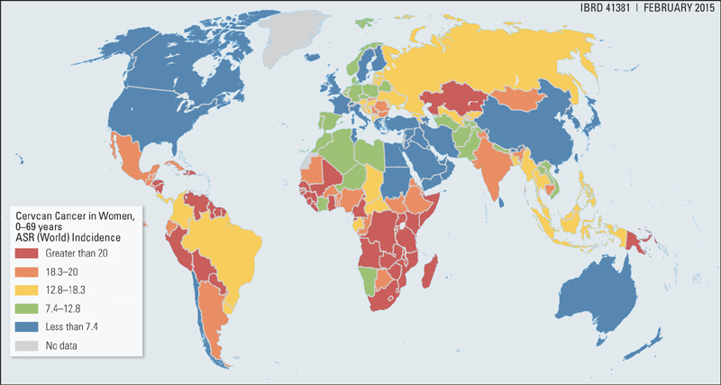
4th most common cancer
90% preventable
311 000
deaths in 2018
Notes:
And yet in 2018, 311 000 women died from this disease.
This is due to three main reasons:

Slide 3
Introduction
The field of medical diagnostics is witnessing a revolutionary shift with the integration of artificial intelligence (AI) and deep learning. Cervical cancer, the 4th most common cancer worldwide, remains a significant health burden, particularly in low-resource regions. While conventional diagnostic techniques are often time-consuming, error-prone, and resource-intensive, deep learning models provide a promising alternative for accurate and efficient classification of medical images.
This study aims to investigate the performance of Convolutional Neural Networks (CNNs), a widely used architecture for image classification, and explore its transformation into Long Short-Term Memory (LSTM) and Artificial Neural Networks (ANN). The primary goal is to evaluate how these modifications affect accuracy and overall model performance for cervical cancer classification.
Notes:
This is Lily. she is a 27-year old woman who was diagnosed with CC after suffering from horrible pain for almost a year. After few weeks of treatment, she wasn’t getting better. Her doctor discovered that she was on a wrong treatment plan because the position of her cervix had been misclassified.
Thankfully, the doctors were able to change her treatment on time and she is now a cancer survivor.
But like Lily, there are thousands of women whose mistreatment goes undiscovered.
Let’s think how lily’s life would have been different if she was able to know that she was high risk and how it would have been different if there was a tool to better assess the position of her cervix.
(but dont get the chance of getting diagnosed at the right time with the right treatment)

Slide 4


Lack of sexual health education
Notes:
Lack of sexual health education
In many societies around the world, it is still a taboo to talk about Sexually Transmitted Infections which are the major cause of cervical cancer.
As a result, women are often not aware of protection methods or of the risk of developing cancer.

Slide 5
Lack of sexual health education
No access to screening
Notes:
2. No access to screening
Many women do not have access to screening centres and even when they do, Doctors are not always able to accurately diagnose precancerous cells in the cervix.

Slide 6
Lack of sexual health education
No access to screening
Poorly customized treatment
Notes:
3. Poorly customized treatment
Even when the precancerous cells are screened accurately, treatments are seldom properly adapted to the individual patient’s cervix position. This can be extremely dangerous because “A treatment which works effectively for one woman may obscure future cancerous growth in another woman.”

Slide 7
Problem Statement
Building upon the paper's CNN-based methodology, which achieved an accuracy of 98.26%, our goal is to push the classification accuracy beyond 99%. To achieve this, we independently implemented LSTM and ANN architectures, leveraging their unique strengths for medical image classification. LSTM was used to capture sequential dependencies from image tiles, enriching feature representation and enabling better temporal understanding. ANN, on the other hand, provided a lightweight yet powerful framework, using CNN-extracted features to perform precise and efficient classification.
In addition to exploring these architectures, we focused on fine-tuning hyperparameters and layers for each model to improve their generalization capabilities. We also applied advanced data augmentation techniques to expand the dataset's diversity and reduce overfitting risks. By independently evaluating LSTM and ANN alongside CNN, we aimed to identify the most effective approach for optimizing cervical cancer classification accuracy while addressing the limitations of existing methodologies.
Notes:
But What do we mean by the position of the cervix? What is the cervix anyway?
The cervix is located at the entrance of the uterus.

Slide 8
Review of Paper
In their experiment, all images were resized to 224 x 224 pixels and split into three sets: 70% for training, 10% for validation, and 20% for evaluation. Initially, features were extracted and stored from the last convolutional layer (7 x 7 x 512) of the VGG-16 architecture. These deep learning-derived features were then utilized in a fine-tuned VGG-16 classifier, which achieved an accuracy of 97%. This process laid the foundation for optimizing the model's performance on the cervical cancer classification task.
During the fine-tuning phase, the first four convolutional blocks of the VGG-16 model were frozen, while the last convolutional block and fully connected layers were redefined. The model was trained using Stochastic Gradient Descent (SGD) as the optimizer and binary cross-entropy as the loss function. Training was conducted for a total of 30 epochs with an initial learning rate of 0.0001 and a batch size of 16. This strategic fine-tuning enabled the model to effectively learn and adapt to the dataset, achieving high accuracy and robust performance.

Slide 9
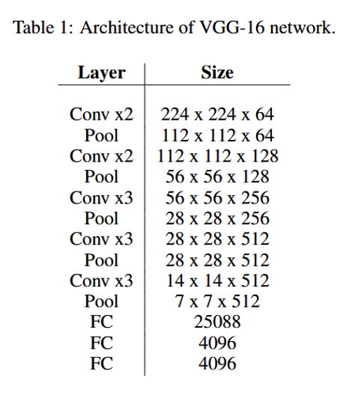
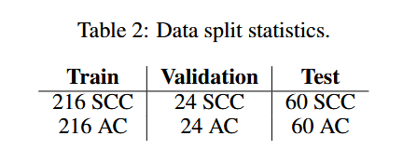
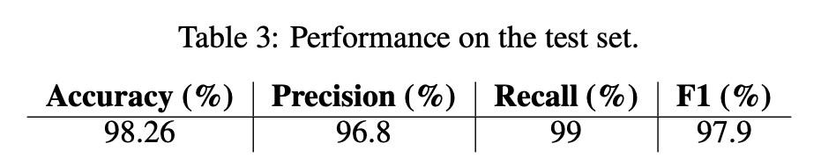
Notes:
It has a part called transformation zone, which is, the most common place for abnormal cells to develop.
Based on the visibility of this transformation zone in each patient,
Disclaimer: the pictures in the following slide contains blood,

Slide 10
Dataset
The dataset contains 858 rows and 36 columns, including data on age, sexual health, smoking habits, contraceptive use, STD history, and diagnostic test results. There are both numerical and categorical variables, with some missing data represented by "?". Key columns include:
Age: Numerical data indicating age.
Number of sexual partners and First sexual intercourse: Numerical or categorical data with missing values.
Smokes, Hormonal Contraceptives, STDs: Indicators with associated numerical details (e.g., years, packs/year).
Diagnostic Results: Columns like "Dx:Cancer," "Hinselmann," "Schiller," "Citology," and "Biopsy" indicating outcomes.
Notes:
The position of the cervix is classified into three different types
In type 1, the transformation zone is fully visible. With type 2, it is semi visible and with type 3, it is not visible at all.
It is very difficult for doctors as well, to distinguish between the types as the position is not always this clear.

Slide 11
The dataset reveals that the participants have a mean age of approximately 26.82 years, with a median age of 25 years, and half of the individuals are between 20 and 32 years old. On average, participants reported around 2.28 pregnancies. A significant majority, 85.4%, do not smoke, leaving 14.6% identified as smokers. In terms of health-related findings, 89.5% of the participants reported no diagnosis of sexually transmitted diseases (STDs), whereas 10.5% reported at least one STD diagnosis.
Cancer and biopsy data provide additional insights into the health conditions within the dataset. Only 2.1% of participants have been diagnosed with cancer, while a staggering 97.9% are cancer-free. Similarly, biopsy results indicate that 93.6% of cases returned negative outcomes, while 6.4% yielded positive results. These findings highlight critical aspects of health-related behaviors and conditions among the study population.

Slide 12
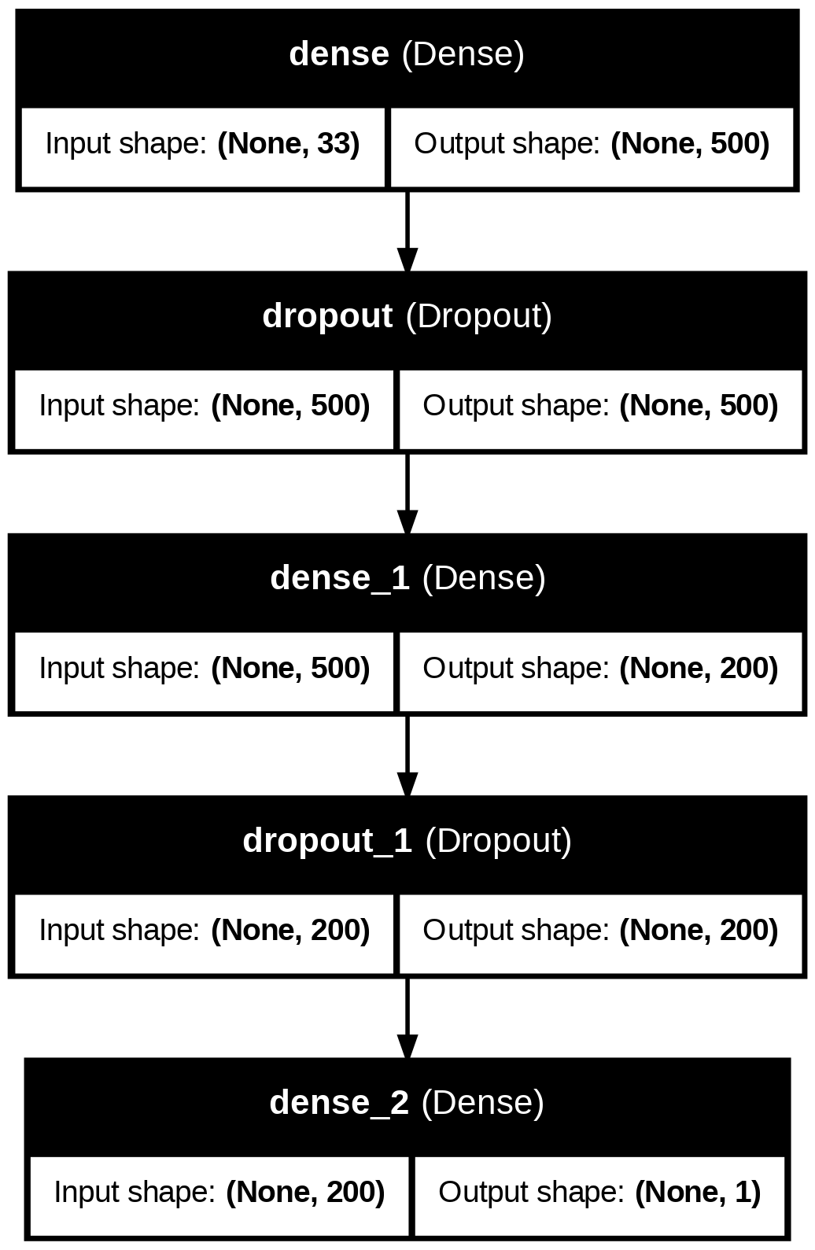
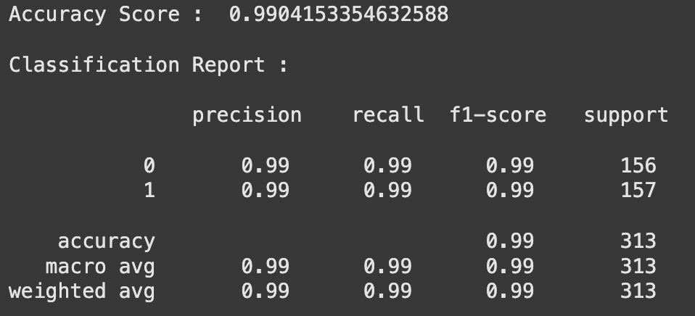
ANN Architecture

Slide 13
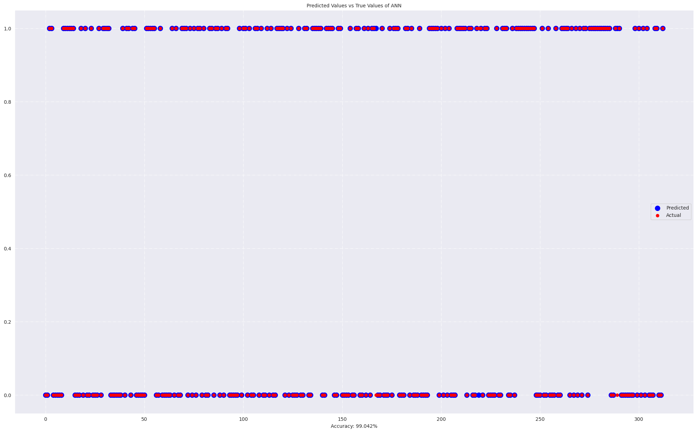

Slide 14
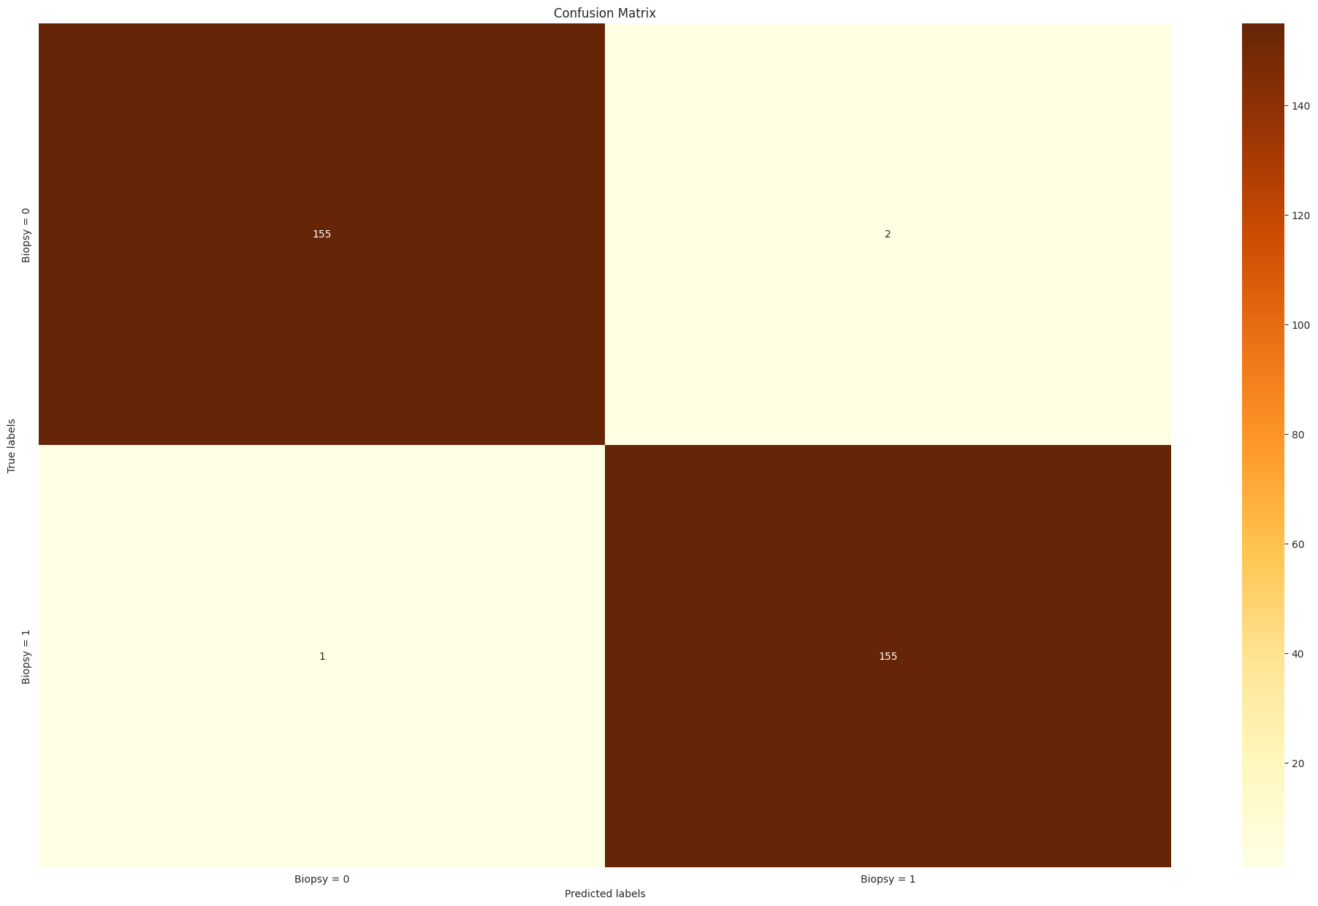

Slide 15
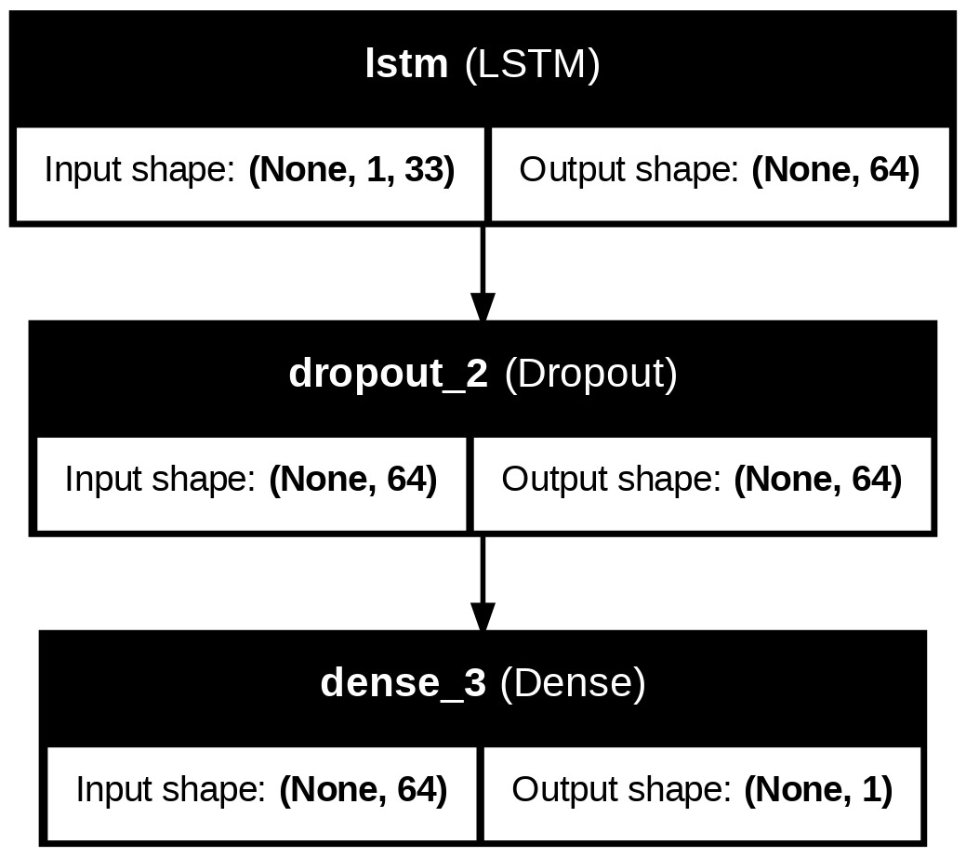
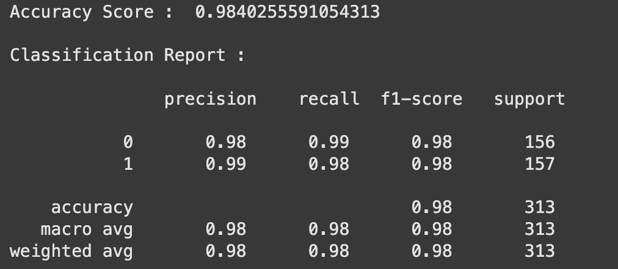
LSTM Architecture

Slide 16
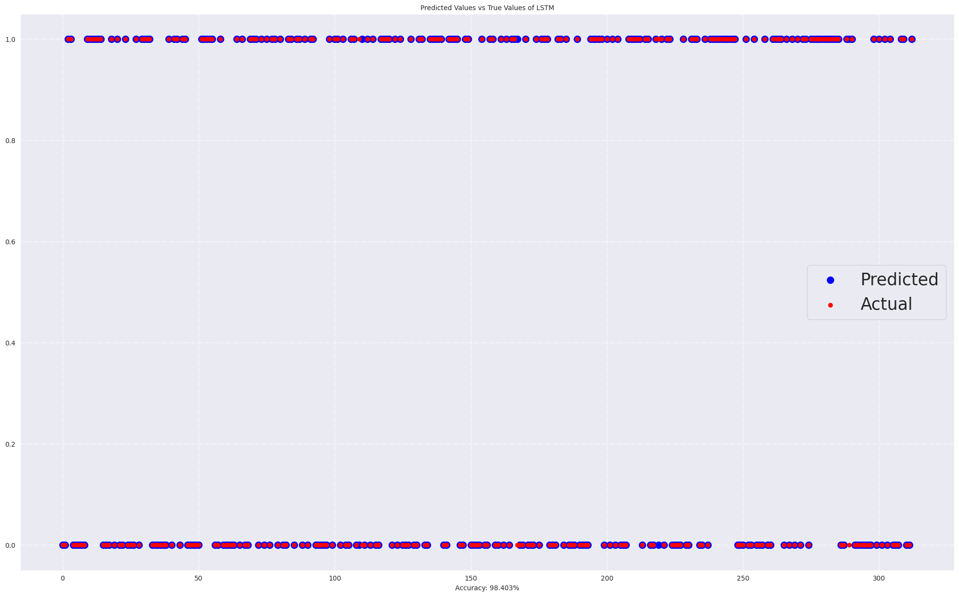

Slide 17
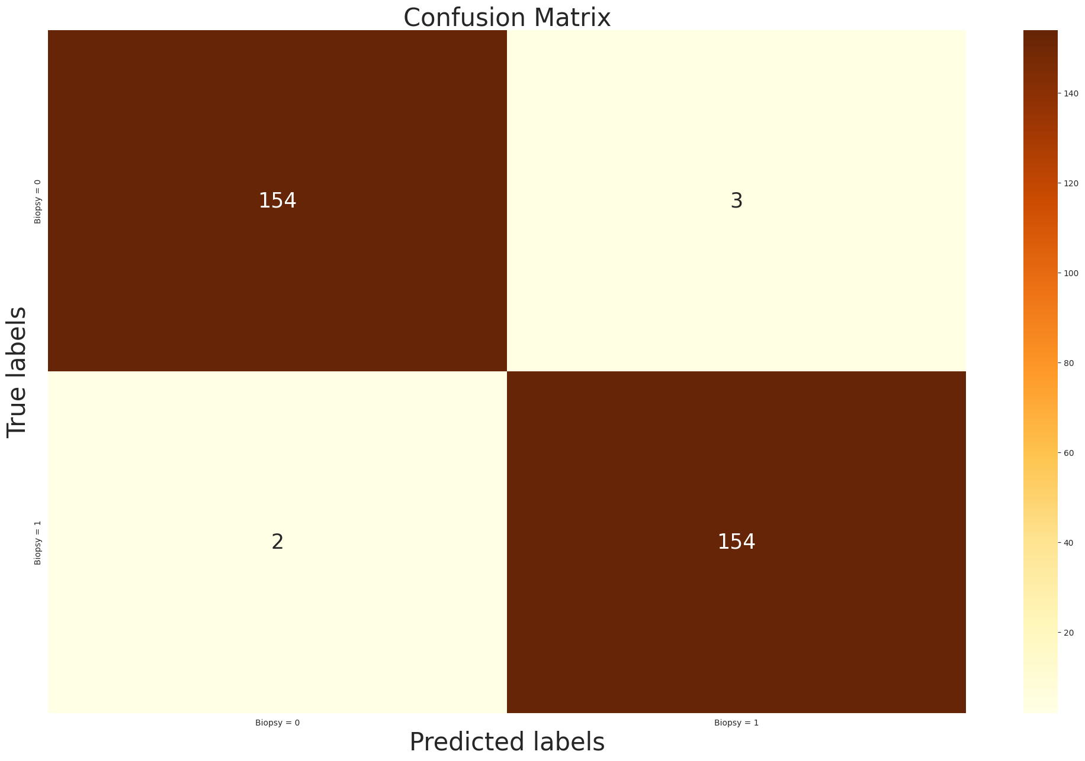

Slide 18
Future Work
Future work will focus on leveraging larger and more diverse annotated CSV datasets to enhance model generalization and robustness. Expanding the dataset will provide a richer feature space and reduce biases that arise from limited or imbalanced data. Incorporating additional features or metadata, such as patient demographics or clinical outcomes, could offer a more holistic approach to classification. Moreover, integrating advanced architectures like transformers, which excel at handling sequential and tabular data, may lead to significant improvements in the accuracy and interpretability of results.
Optimization efforts will include hyperparameter tuning to identify optimal configurations for learning rates, activation functions, and network parameters tailored for tabular data. The implementation of ensemble learning techniques, combining predictions from multiple models such as CNN, LSTM, and ANN, could further enhance performance by exploiting the strengths of each approach. Additionally, exploring feature engineering and feature selection methods will ensure that the most relevant information is utilized, paving the way for more accurate and scalable solutions for cervical cancer classification.

